Slide 1
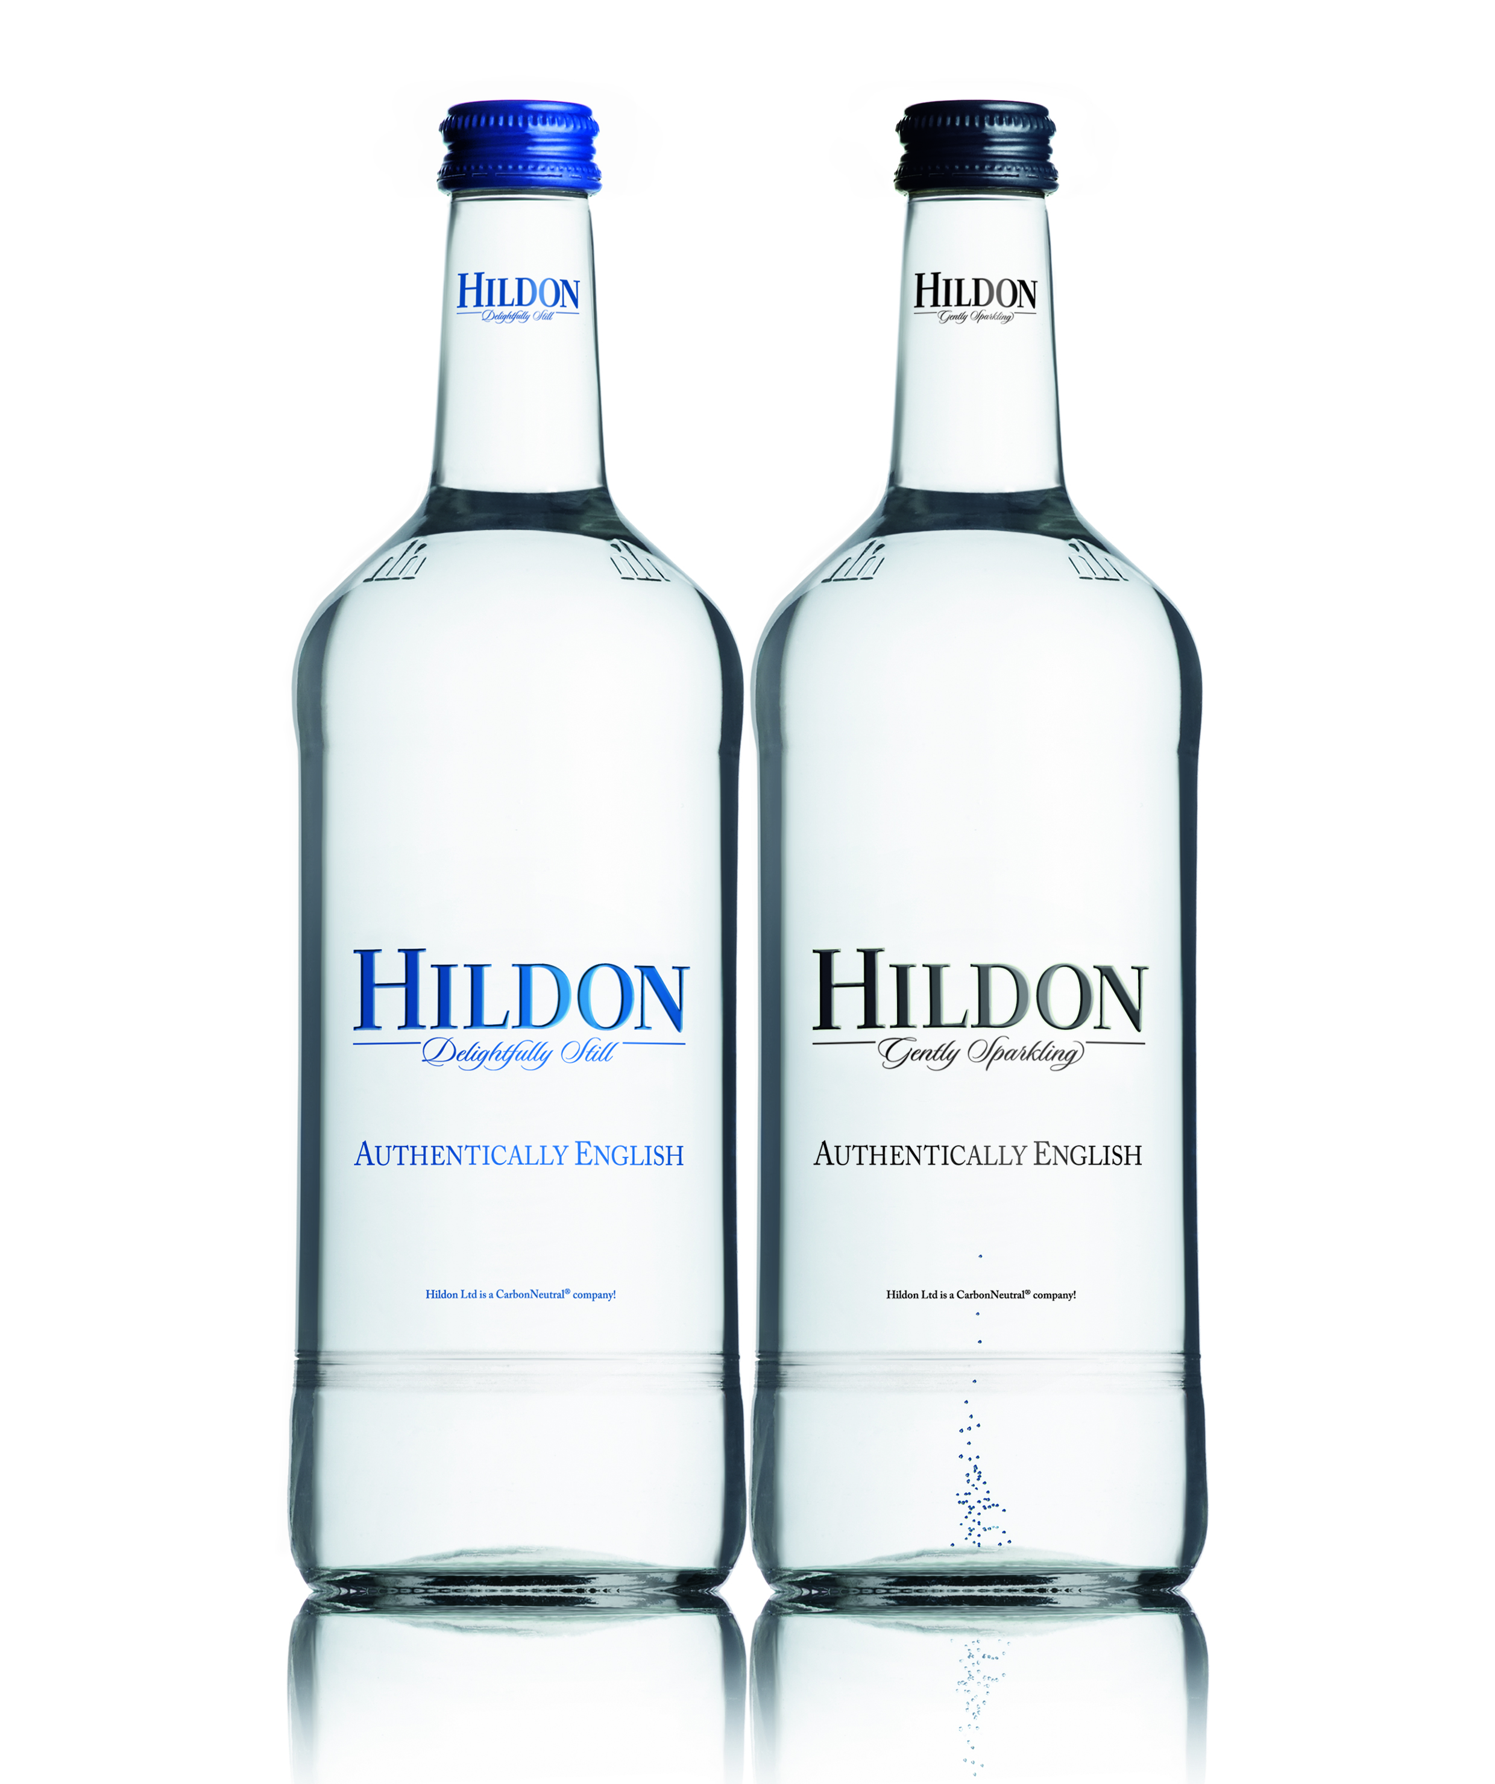


Slide 2
Background to Hildon
Hildon Ltd was established 1989 – a local employer of 60.
Produces 30 million bottles per year .
Exports to over 20 markets including :
North America, Europe, the Middle East, Asia & the Far East.
Excellent brand equity:
High profile customers – exclusive restaurants and hotels.
Strong reputation for quality, service and reliability.
Well established brand - high consumer awareness.
Hildon is the leading brand in the HoReCa market
(hotels restaurants catering)

Slide 3
Natural Mineral Water
Bottle vs Spring vs Natural Mineral Water
International controls and regulations govern the source, bottling procedures and constant mineral constitution.
Natural Mineral Water must be bottled at source and cannot be treated.
Only waters that have undergone a two-year test period and conform to stringent legislation can be classed as “Natural Mineral Water”.
Hildon’s source is deep within the chalk hills of Hampshire and it takes 20 - 50 years to reach whilst filtering through the chalk strata. This filtration process gives a unique taste, purity and mineral content.
The Hildon source is 70 metres below ground.

Slide 4
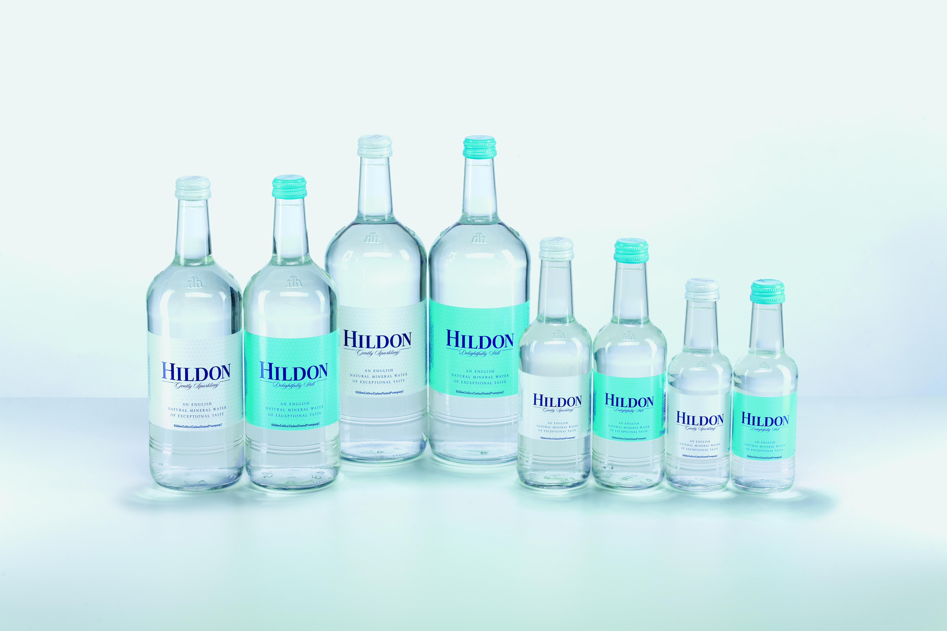
Glass Range

Slide 5
Hildon’s PET Range
PET range is now available in Still & Sparkling.
Hildon’s PET range is 100% recyclable and is designed for use in areas where glass cannot be used - leisure areas, spa’s, pool-sides, golf courses etc.
It’s available with both flat caps or pull push:
1 litre,750ml, 500ml or 330ml flat cap
500ml or 330ml PP
New sizes now launched, with same visual characteristics as the glass bottle, in 1litre and 750ml flat cap.
Designed for consumer use at home and for caterers with outside catering events – sports events, weddings, travel etc.
Carbonated options now include our 330ml, 500ml and 750ml products.

Slide 6
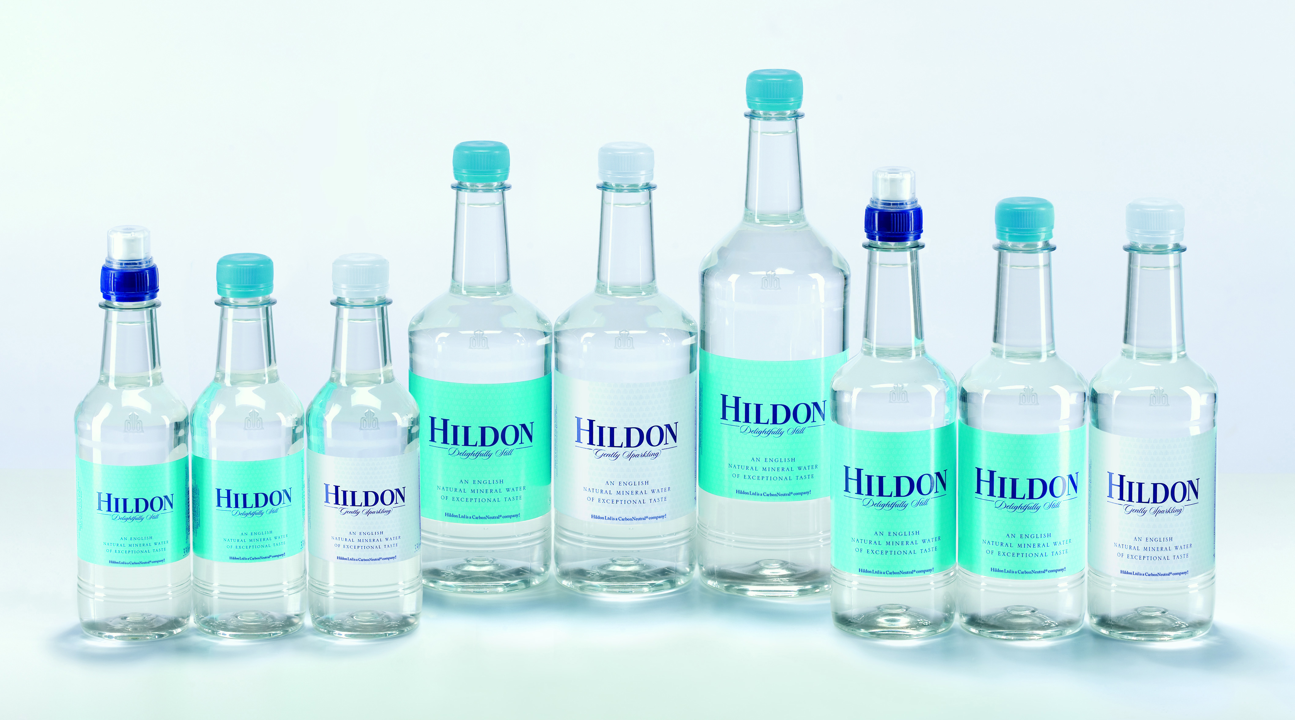
The PET Range

Slide 7



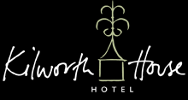


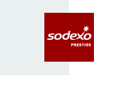



Some of Our UK Partners

Slide 8
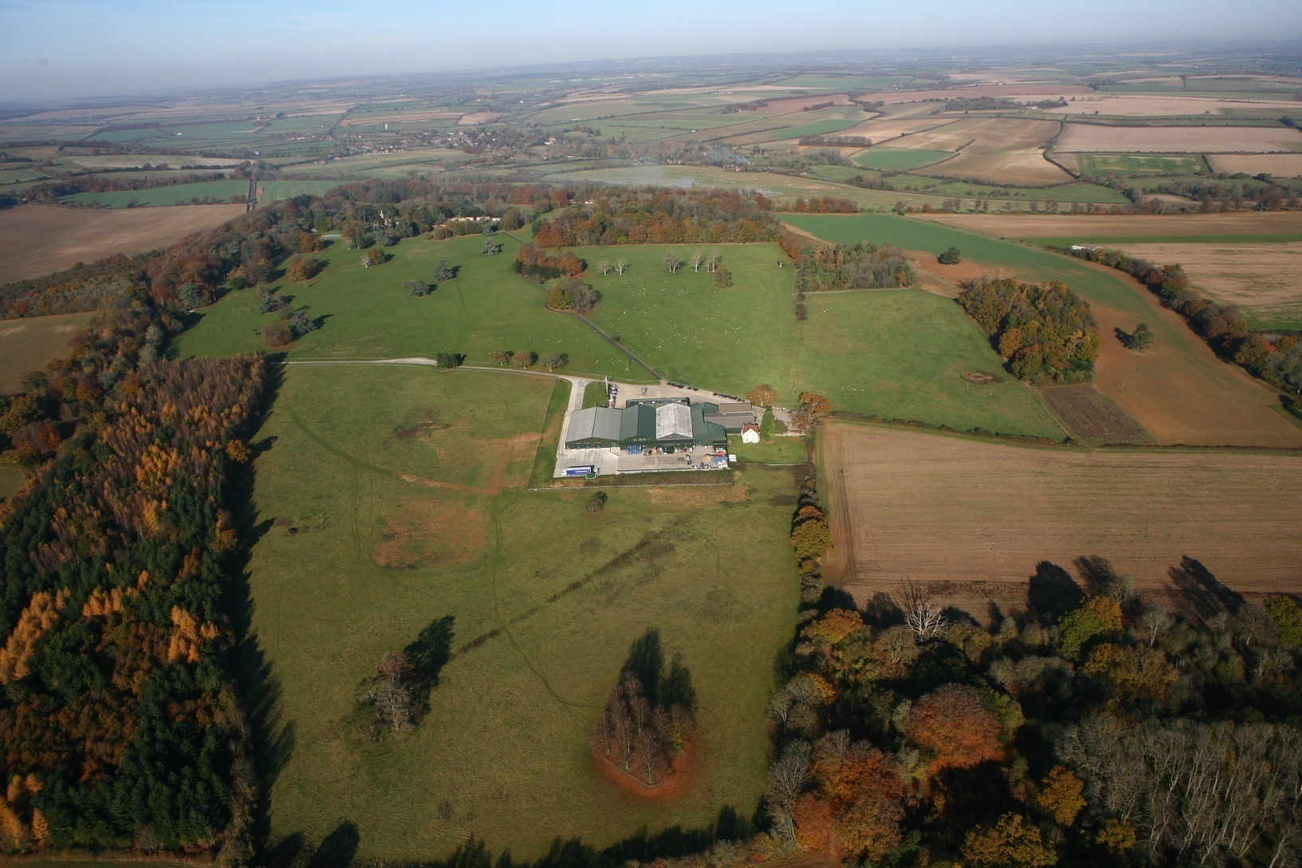
Hildon & the Environment

Slide 9

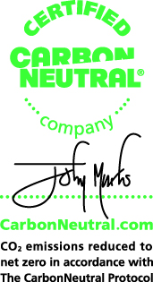

Hildon & the Environment
Full-time environmental manager.
Environmental policy in place.
Worked with organisations such as the Carbon Trust , Envirowise and Olive.
Members of the Sustainable Business Partnership and reached the finals of the awards 2008.
Protect and encourage wildlife on our 150 acres of parkland.
Driven down our electrical usage by approx 16% 2008 V 2007 and 15% 2009 V 2008.
Achieved by:
Good house keeping
Staff awareness
Investment in efficient machinery and processes
We are a Carbonneutral® company.
Continuous investment in our transport fleet.
2 Modec Electric vehicles on our fleet for London deliveries.
Fleet is less than 3 years old and we always purchase the best performing emissions rated vehicles available.

Slide 10
Hildon Packaging
We have been supplying Glass & PET “Natural Mineral Water” in both “Delightfully Still” and “Gently Sparkling” for 20 years.
Hildon is now a major Brand in the UK Market and a market leader in the On Trade.
We specialise in serving the HORECA trade and Hotels in particular.
We are the first and only water company using electric vehicles for deliveries.
We employ a dedicated Environmental Manager to drive all our environmental initiatives.

Slide 11
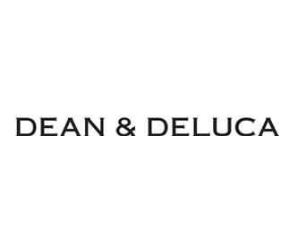



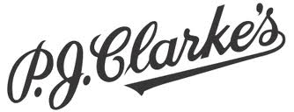



Some of Our US Partners

Slide 12
FINE BEVERAGE LLC 1869 North University Drive Coral Springs, FL 33071 T. 561.756.6825 David Hanna
US Presentation

